Slide 1
ARCHITECTURE + VALUE STORY
Correlation Engine
NET1
From parallel security events to explainable incidents
EDR2
NET3
Validates + normalizes
OS3
Create a common event language
Suppresses noise
NET4
Keep false positives out of clusters
Outlier
RF5
Correlates evidence
Distance-based clustering across dimensions
Manages lifecycle
Incident cluster
Create, escalate, merge, and close incidents
CorrEngine | Architecture + value narrative | Redesigned deck

Slide 2
CORRELATION ENGINE
02/24
What CorrEngine delivers
Noise reduction
Context preservation
Drops duplicates, aggregates repeats, and suppresses known benign activity.
Joins evidence across time, host, sensor, MITRE, and risk dimensions.
Incident quality
Operational control
Produces fewer, richer incidents instead of isolated alerts.
Supports merging, escalation, traceability, and downstream notification.
Value story
Raw telemetry
Comparable events
Correlated cluster
Actionable incident
CorrEngine | Architecture + value narrative | Redesigned deck

Slide 3
CORRELATION ENGINE
03/24
Parallel event story we will follow
Four tracks arrive independently. The engine must decide which ones belong together, which ones stay separate, and which ones are safely suppressed.
Track A
SRV-DB01 multi-stage attack
EDR2 process injection | OS3 registry modification | NET1 beaconing | NET4 HTTP exfiltration
Track B
RF anomaly
RF5 rogue access point | No close neighbors
Track C
Benign maintenance
PATCH7 scheduled patch | PATCH8 repeat patch | Candidate for suppression
Track D
Remote workstation signal
NET3 beaconing from ENG-WS17 | May bridge into Track A cluster
CorrEngine | Architecture + value narrative | Redesigned deck

Slide 4
CORRELATION ENGINE
04/24
High-level architecture: publish, process, persist
Only the broker and sequential database are shown as requested. Infrastructure detail is intentionally abstracted.
Sensors
Pub/sub broker
Ingest
Normalize
Suppress
CorrEngine
Sequential database
Consumers / API
Correlate
Manage
Less noise
More context
Faster action
fewer alerts
cross-sensor story
incident ready
CorrEngine | Architecture + value narrative | Redesigned deck

Slide 5
CORRELATION ENGINE
05/24
Canonical event envelope
Before correlation can happen, every incoming event is transformed into a shared structure that supports comparison.
Comparable
Identity
eventId, eventType, timestamp
Supports distance math
same dimensions across sensors
weights need clean dimensions
Source
sensor type, source, destination
Explainable
Context
hostname, subnet, asset, site
why events did or did not join
Supports policy logic
MITRE tactic / technique
suppression and bypass rules
Threat lens
Traceable
Risk
severity, risk score, criticality
supports incident audit trail
Lifecycle
ingested, suppressed, clustered, incident
CorrEngine | Architecture + value narrative | Redesigned deck

Slide 6
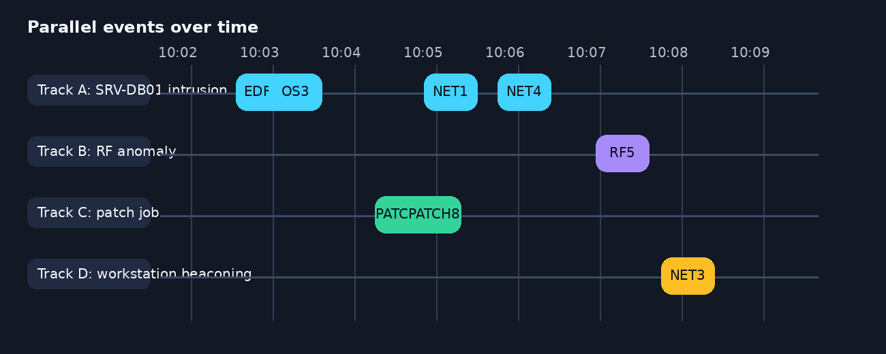
CORRELATION ENGINE
06/24
Raw events arrive in parallel
At ingestion time, nothing is yet correlated. The engine sees independent observations arriving from different sources at different moments.
Key point
Why visualized
Next step
Temporal proximity helps, but time alone never proves correlation.
Mixed audiences can see that the engine starts with ambiguity, not certainty.
Every event must pass ingest controls before it can enter the candidate pool.
CorrEngine | Architecture + value narrative | Redesigned deck

Slide 7
CORRELATION ENGINE
07/24
Stage 1: ingestion gate
The first job is defensive: protect data quality and preserve trustworthy evidence.
NET1
INGESTION GATE
Accept
Schema validation
trusted event enters candidate pool
EDR2
Idempotency check
Retry / DLQ
OS3
Persistence write
bad or unprocessable messages stay visible
Archive trigger
RF5
ACK / retry decision
CorrEngine | Architecture + value narrative | Redesigned deck

Slide 8
CORRELATION ENGINE
08/24
Validation and idempotency
What must be true
Idempotency example
✓
Schema matches expected payload
The same event should not create duplicate evidence or duplicate incidents.
✓
eventId is present and unique
eventId=NET1
eventId=NET1
eventId=NET3
✓
Required fields can be normalized
NET1 is retried or re-sent → still one logical event in the system.
✓
Event timestamp is usable
Single accepted record
✓
Source metadata is trustworthy enough to continue
Why it matters
Without validation and idempotency, the engine could correlate bad payloads or count the same evidence multiple times.
CorrEngine | Architecture + value narrative | Redesigned deck

Slide 9
CORRELATION ENGINE
09/24
Persist and acknowledge before interpretation
CorrEngine first commits the event trail, then allows higher-order logic to act on a durable record.
Broker
CorrEngine
Database
Archive
deliver event
write event
write OK
archive copy
ACK message
Operational meaning
User-facing benefit
Resilience
ACK is not a “best effort” shortcut; it follows durable handling.
Analysts can trust that the incident story is backed by stored evidence.
Failed writes should lead to retry logic rather than silent loss.
CorrEngine | Architecture + value narrative | Redesigned deck

Slide 10
CORRELATION ENGINE
10/24
Normalization: sensor-native telemetry becomes comparable evidence
Network
Comparable
Canonical event model
srcIP, dstIP, flow, beacon
events now share dimensions for distance calculation
identity
EDR
source/destination
Explainable
process, parent, hash, user
hostname
analysts can see why NET1 is closer to EDR2 than RF5
MITRE
OSF
risk
Portable
registry, service, file, host
timestamps
policy and clustering logic no longer depend on sensor-specific payloads
CorrEngine | Architecture + value narrative | Redesigned deck

Slide 11
CORRELATION ENGINE
11/24
Enrichment adds operational context
Normalization makes events comparable; enrichment makes them meaningful.
Before enrichment
After enrichment
Why it matters
Context changes both distance scoring and incident urgency.
asset criticality = high
NET1
owner = Finance
host=SRV-DB01
site = HQ
Suppression impact
sensor=Network
subnet = 10.0.5.0/24
Critical assets can bypass normal suppression rules.
tactic=C2
risk score = 64
critical-asset bypass = true
Sales pitch angle
A better incident is not only accurate; it is business-aware.
CorrEngine | Architecture + value narrative | Redesigned deck

Slide 12
CORRELATION ENGINE
12/24
Suppression and aggregation remove known noise
A correlation engine is judged as much by what it excludes as by what it clusters.
Duplicate detection
Time-window aggregation
drop redundant repeats in a short window
roll identical repeats into one evidence item
False-positive rules
Critical-asset bypass
suppress known benign activity by IP, type, host, sensor
do not suppress events from assets that must always be reviewed
12 raw events
8 candidate events
5 clusterable events
1 incident
CorrEngine | Architecture + value narrative | Redesigned deck

Slide 13
CORRELATION ENGINE
13/24
After suppression, events split into three possible outcomes
Correlation candidate
Separate path
Suppressed / FP
enter distance calculation and clustering
valid signal, but no close neighborhood
retained with traceability, excluded from correlation
NET1
RF5
PATCH7
EDR2
PATCH8
OS3
NET4
NET3
These are the events that form the main incident example.
Useful evidence can remain outside the main cluster.
Suppression is deliberate exclusion, not data deletion.
CorrEngine | Architecture + value narrative | Redesigned deck

Slide 14
CORRELATION ENGINE
14/24
High-level distance formula
Temporal
30%
D(Eᵢ, Eⱼ) = Σ (wₖ × dₖ)
Spatial
25%
CorrEngine compares each event pair across weighted dimensions. A lower value means “closer” behavior; a higher value means “less likely to belong together.”
MITRE
25%
Sensor
10%
Risk
10%
Hidden low-level detail
Exact normalization and edge cases remain implementation detail, not slide clutter.
CorrEngine | Architecture + value narrative | Redesigned deck
Notes:
Hidden technical detail: D(Ei,Ej) = Σ(wk*dk). Weights from SRS example: temporal 0.30, spatial 0.25, MITRE 0.25, sensor 0.10, risk 0.10. Temporal normalization uses minute delta capped at 1.0. Spatial compares hostname/subnet/other. MITRE uses Jaccard distance. Sensor is 0 or 1. Risk uses linear scaling.

Slide 15
CORRELATION ENGINE
15/24
What the five dimensions actually mean
Temporal
Spatial
How close are the event timestamps?
Do the hostnames or subnets match?
MITRE
Sensor
Do they align to similar tactics?
Do the sensor types match or differ?
Risk
Are the risk scores in a similar range?
In practice, no single dimension decides on its own. The score reflects combined evidence.
CorrEngine | Architecture + value narrative | Redesigned deck

Slide 16
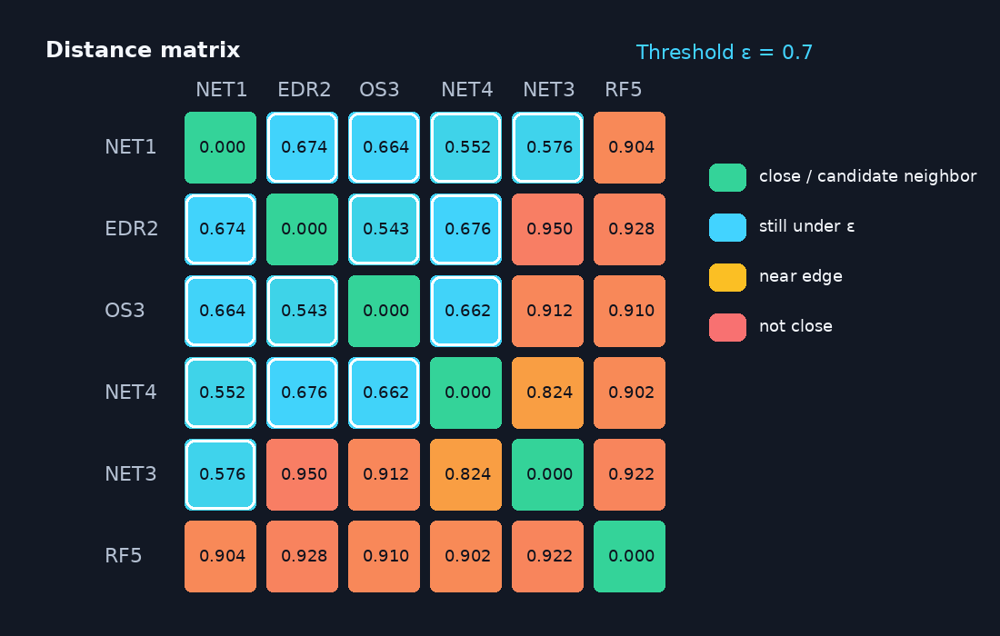
CORRELATION ENGINE
16/24
Distance matrix: who is close enough to be neighbors?
Values below ε = 0.7 are highlighted as possible neighborhood links. This gives a visual bridge from the formula to clustering behavior.
CorrEngine | Architecture + value narrative | Redesigned deck
Notes:
Hidden detail: Example distance matrix uses events NET1, EDR2, OS3, NET4, NET3, RF5 and epsilon 0.7. Candidate neighbor links are values <= 0.7.

Slide 17
CORRELATION ENGINE
17/24
DBSCAN logic: core, border, and noise
ε-neighborhood
Core point
enough neighbors within ε
EDR2
NET3
NET1
NET4
Border point
OS3
close to a core, but with fewer neighbors
RF5
Noise / outlier
not within a dense neighborhood
Why DBSCAN fits
It discovers clusters without forcing every event into a group.
CorrEngine | Architecture + value narrative | Redesigned deck
Notes:
Hidden detail: Core point means at least minPts neighbors within epsilon. Border point is inside a core neighborhood but has fewer neighbors. Noise is neither core nor border.

Slide 18
CORRELATION ENGINE
18/24
Worked example: Cluster 1 forms a multi-stage incident
Observed result
SRV-DB01
Five events join into one attack narrative.
NET3
EDR2 execution
ENG-WS17
NET1
OS3 defense evasion
bridging core point
Why it joins
Host overlap, timing, tactics, sensor complementarity, and risk similarity.
NET1 command and control
NET4 exfiltration
Operational meaning
Analysts receive one incident instead of several disconnected alerts.
CorrEngine | Architecture + value narrative | Redesigned deck

Slide 19
CORRELATION ENGINE
19/24
Not correlated does not always mean unimportant
RF5 → separate incident
INC-002
Valid anomaly, but no close neighborhood. It should become its own investigation path.
PATCH7 / PATCH8 → suppressed
SUPPRESSED
Known benign maintenance. These events remain traceable but never enter clustering.
Future lone signal → hold for later
PENDING
A valid event can remain outside the main cluster and still matter if more evidence arrives.
CorrEngine | Architecture + value narrative | Redesigned deck

Slide 20
CORRELATION ENGINE
20/24
Incident lifecycle management
in_progress
resolved
triage
threshold / critical asset
response
closure
new
escalated
closed
Merge logic
Escalation rule
Why this matters
Incidents sharing >50% of events can be merged.
Aggregate risk or critical-asset involvement can auto-escalate.
Correlation without lifecycle control is still unfinished operations.
CorrEngine | Architecture + value narrative | Redesigned deck
Notes:
Hidden detail: Escalation can be automatic when aggregate risk exceeds threshold or a critical asset is involved. Incidents sharing >50% of events can be merged.

Slide 21
CORRELATION ENGINE
21/24
Business value and engineering value align
Fewer alerts
Richer incidents
noise reduction reduces analyst fatigue
multi-sensor context improves triage
Explainable decisions
Operational trust
distance dimensions can be shown to users
durability + lifecycle create auditability
Raw telemetry → incident-grade action
CorrEngine | Architecture + value narrative | Redesigned deck

Slide 22
CORRELATION ENGINE
22/24
High-level module decomposition
Pub/sub message broker
Event ingestion
Normalization
Suppression
Correlation
Incident manager
Sequential database
CorrEngine | Architecture + value narrative | Redesigned deck

Slide 23
CORRELATION ENGINE
23/24
Risks and operational controls
Message loss before ACK
High-density clustering slowdown
Use durable handling, retries, and visibility into failures.
Validate parameter defaults and scaling behavior.
Schema evolution breaks ingest
Feedback loops / event storms
Version payloads and test compatibility.
Block self-generated re-entry and control amplification.
Takeaway
Accuracy is necessary, but production readiness depends on resilient event handling and guardrails.
CorrEngine | Architecture + value narrative | Redesigned deck

Slide 24
CORRELATION ENGINE
24/24
Final message
Correlation is the bridge between telemetry and action.
Start with ambiguity
Independent events arrive in parallel.
Earn the cluster
Validation, normalization, suppression, and distance scoring prove similarity.
End with action
The output is an incident story with lifecycle control.
CorrEngine turns parallel observations into explainable incidents.
CorrEngine | End of deck

